Slide 1

Managerial Decision Making

Slide 2


Slide 3
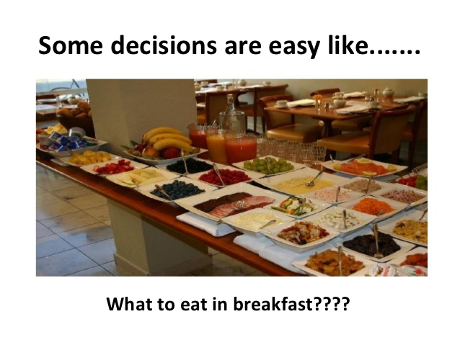

Slide 4
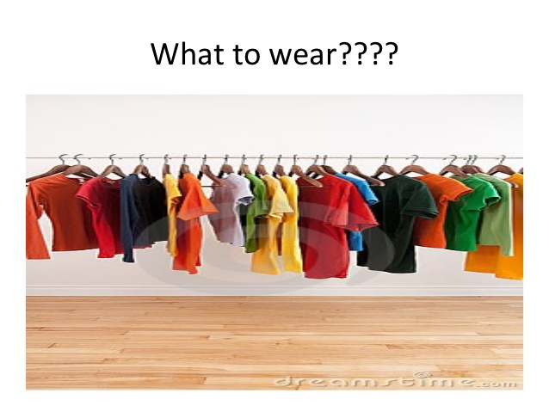

Slide 5


Slide 6


Slide 7


Slide 8


Slide 9
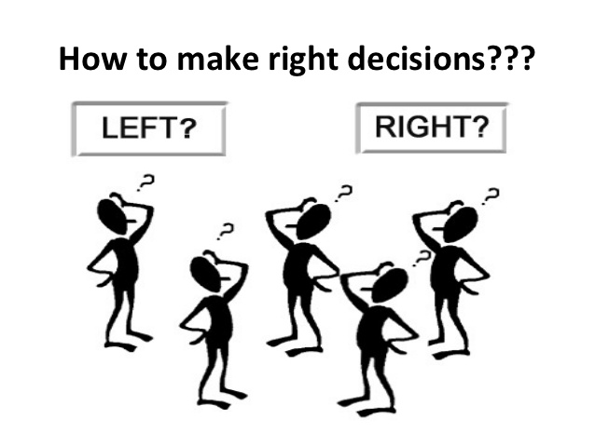

Slide 10

Economic Decision Making
Decision making is not easy
It must be done amidst
ever-changing factors
unclear information
conflicting points of view
Manager’s Challenge: Tupperware

Slide 11
Decisions and Decision Making
Decision = choice made from available alternatives
Decision Making = process of identifying problems and opportunities and resolving them

Slide 12
Certainty, Risk, Uncertainty, Ambiguity
Certainty
all the information the decision maker needs is fully available
Risk
decision has clear-cut goals
good information is available
future outcomes associated with each alternative are subject to chance
Uncertainty
managers know which goals they wish to achieve
information about alternatives and future events is incomplete
managers may have to come up with creative approaches to alternatives
Ambiguity
by far the most difficult decision situation
goals to be achieved or the problem to be solved is unclear
alternatives are difficult to define
information about outcomes is unavailable

Slide 13

Categories of Decisions
Programmed Decisions
Situations occurred often enough to enable decision rules to be developed and applied in the future
Made in response to recurring organizational problems
Nonprogrammed Decisions –
in response to unique, poorly defined and largely unstructured, and have important consequences to the organization
Ethical Dilemma: The No-Show Consultant

Slide 14
Selecting a Decision Making Model
Depends on the manager’s personal preference
Whether the decision is programmed or non-programmed
The decision is characterized by risk, uncertainty, or ambiguity

Slide 15
Classical Model
Logical decision in the organization’s best economic interests
Assumptions
Decision maker operates to accomplish goals that are known and agreed upon
Decision maker strives for condition of certainty – gathers complete information
Criteria for evaluating alternatives are known
Decision maker is rational and uses logic
Normative = describes how a manager should and provides guidelines for reaching an ideal decision

Slide 16
Administrative Model
How nonprogrammer decisions are made--uncertainty/ambiguity
Managers actually make decisions in difficult situations characterized by non-programmed decisions, uncertainty, and ambiguity
Decision goals often are vague, conflicting and lack consensus among managers;
Rational procedures are not always used
Managers’ searches for alternatives are limited
Managers settle for a satisfying rather than a maximizing solution
intuition, looks to past experience
Descriptive = how managers actually make decisions--not how they should

Slide 17
Political Model
Closely resembles the real environment
Closely resembles the real environment in which most managers and decision makers operate
Useful in making non-programmed decisions
Decisions are complex
Disagreement and conflict over problems and solutions are normal
Coalition = informal alliance among manages who support a specific goal

Slide 18
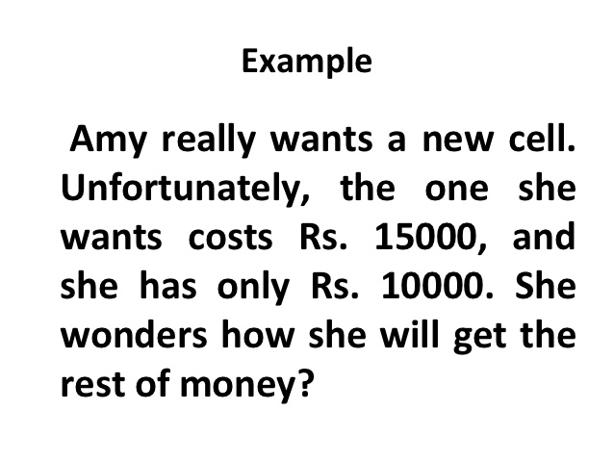

Slide 19


Slide 20


Slide 21


Slide 22


Slide 23
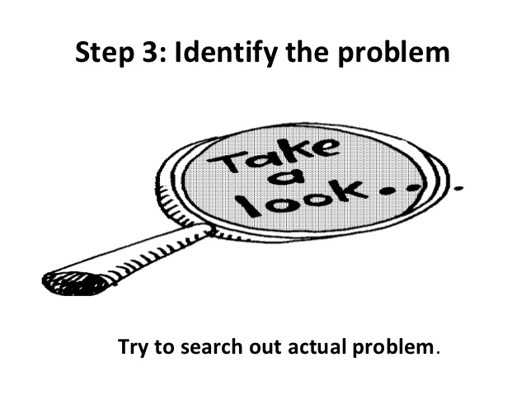

Slide 24
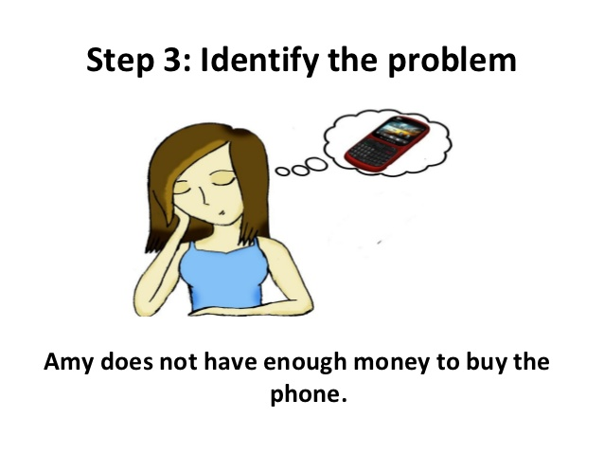

Slide 25


Slide 26
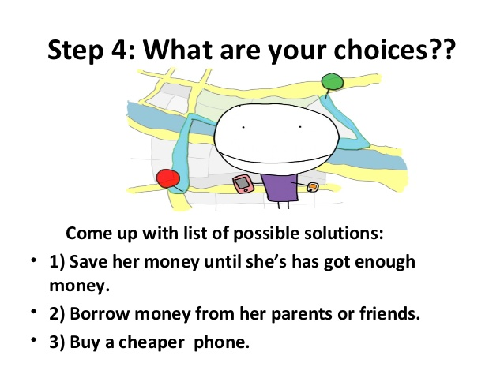

Slide 27
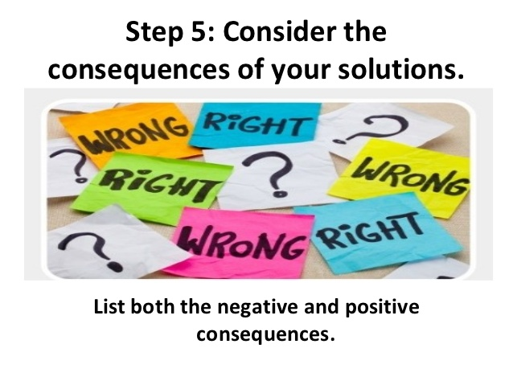

Slide 28


Slide 29
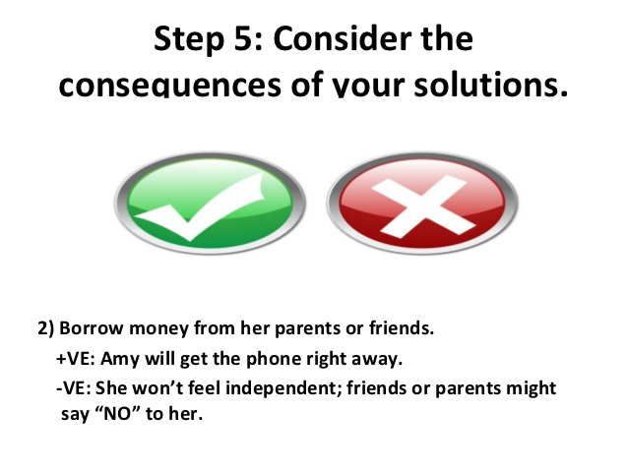

Slide 30
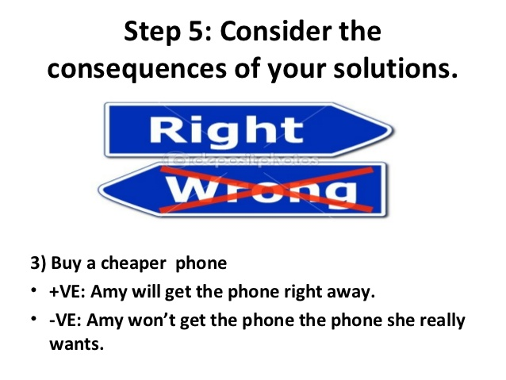

Slide 31


Slide 32
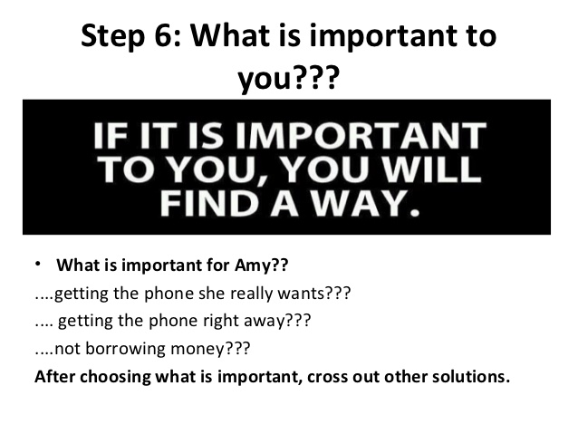

Slide 33


Slide 34
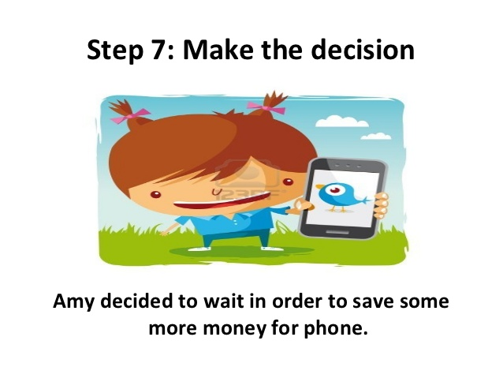

Slide 35


